Slide 1
Module 7
Hypothesis Testing

Slide 2
Announcements

Slide 3
What are you thinking?
What does this make you wonder?

Slide 4
How many is too many?
How many might land butter-side-up, if both sides are equally likely?
How high might it go?
(Demo)

Slide 5
Science
Hypothesis: The sun always rises in the east.
Prediction: If you observe a bunch of sunrises, all of them will be in the east.
Test: Go watch some sunsets.

Slide 6
Science
Hypothesis: All swans are white.
Prediction: If you observe a bunch of swans, all of them will be white.
Test: Go find swans.

Slide 7
Where it gets hairy
Hypothesis: Most swans are white.
Prediction: ???
Test: ???

Slide 8
Dealing with randomness
Hypothesis: At least 99% of swans are white.
Prediction: ???
Test: ???

Slide 9
Dealing with randomness
Hypothesis: At least 99% of swans are white.
Prediction: If you observe a random sample of 100 swans, at least 99 will be white.
Test: ???

Slide 10
Dealing with randomness
Hypothesis: At least 99% of swans are white.
Prediction: If you observe a random sample of 100 swans, more likely than not, at least 99 will be white.
Test: ???

Slide 11
Dealing with randomness
Hypothesis: At least 99% of swans are white.
Prediction: If you observe a random sample of 100 swans, almost certainly, at least 90 will be white.
Test: ???

Slide 12
Dealing with randomness
Hypothesis: At least 99% of swans are white.
Prediction: If you observe a random sample of 100 swans, almost certainly, at least 90 will be white.
Test: Randomly sample 100 swans. Observe their color.

Slide 13
Interpreting the result of a test
Test: Randomly sample 100 swans. Observe their color.
If at least 90 are white: hypothesis could be true.
If fewer than 80 are white: either the hypothesis is false, or a ginormous coincidence just happened.

Slide 14
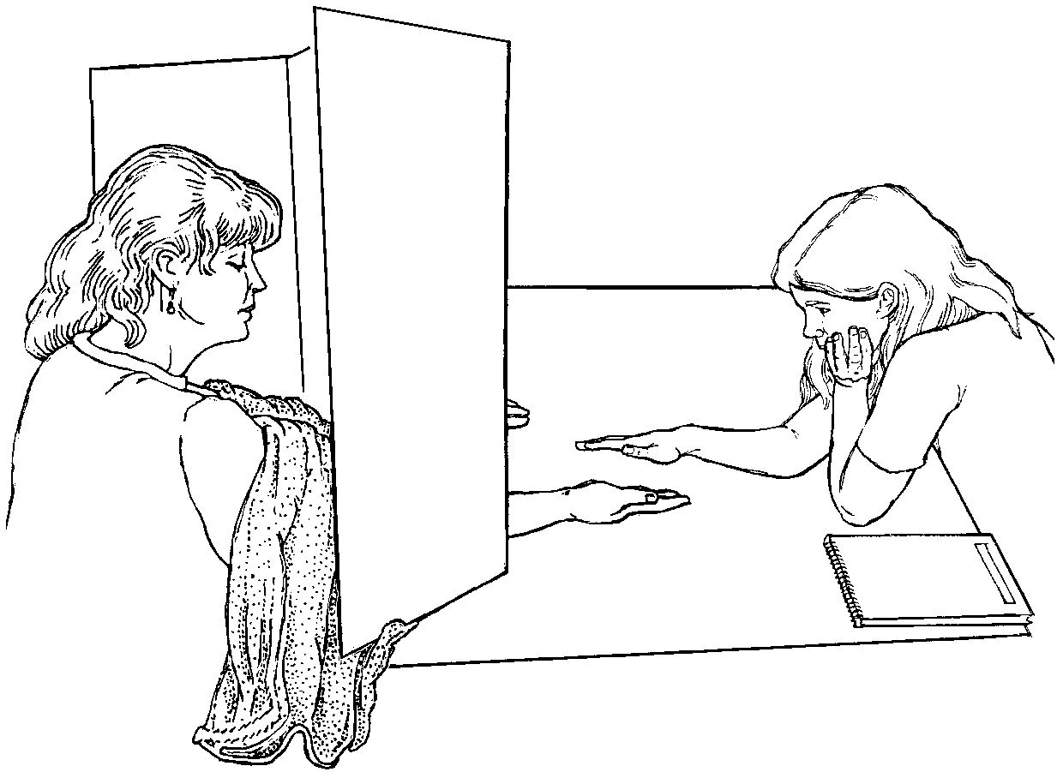
Emily Rosa and the healing touch
Emily Rosa's 4th grade science fair project:
Touch healers say they detect and use the healing energy field (HEF) to cure patients. Can they detect HEF?

Slide 15
Science
Hypothesis: Healers cannot detect HEF better than random guessing.
Prediction: If you test healers 150 times, almost certainly, they'll be right at most 60% of the time.
Test: Go find healers and test them.

Slide 16
Attendance
bit.ly/attend8

Slide 17
Jury Panels

Slide 18
Jury Panels
Eligible jurors in a County
List of eligible residents
Jury panel
Jury
"All persons selected for jury service shall be selected at random, from a source or sources inclusive of a representative cross section of the population of the area served by the court."
(Demo)

Slide 19
Distances

Slide 20
Computing Distance
Every distance has a computational recipe
Total Variation Distance (TVD):
For each category, compute the difference in proportions between two distributions
Take the absolute value of each difference
Sum & divide by 2
Chi Squared (χ² Optional):
For each category, compute the difference in proportions between two distributions
Square each difference and divide by the first proportion
Sum & multiply by sample size
(Demo)

Slide 21
Empirical Distributions

Slide 22
Distribution of a Statistic
Statistic: A quantity computed for a particular sample
Distribution: The chance of each outcome of sampling
Sampling distribution: Chance of each value of a statistic (computed from all possible samples)
Also known as the probability distribution of the statistic
Empirical distribution: Observations of a statistic (computed from some samples drawn at random)
(Demo)

Slide 23
Hypothesis Testing

Slide 24
Testing a Hypothesis
Step 1: The Hypotheses
A test chooses between two views of how data were generated
Null hypothesis proposes that data were generated at random
Alternative hypothesis proposes some effect other than chance
Step 2: The Test Statistic
A value that can be computed for the data and for samples
Step 3: The Sampling Distribution of the Test Statistic
What the test statistic might be if the null hypothesis were true
Approximate the sampling distribution by an empirical distribution

Slide 25
Conclusion of a Test
Resolve choice between null and alternative hypotheses
Compare observed test statistic to its empirical distribution under the null hypothesis
If the observed value is consistent with the distribution, then the test does not support the alternative hypothesis
Whether a value is consistent with a distribution:
A visualization may be sufficient
Convention: The observed significance level (P-value)
(Demo)

Slide 26
Observed Significance Level
P-Value: The chance, under the null hypothesis, that the test statistic is equal to the value that was observed or is even further in the direction of the alternative.
Statistically Significant: The P-value is less than 5%
Highly Statistically Significant: The P-value is less than 1%

Slide 27
Module 7
Error Probabilities

Slide 28
Announcements

Slide 29
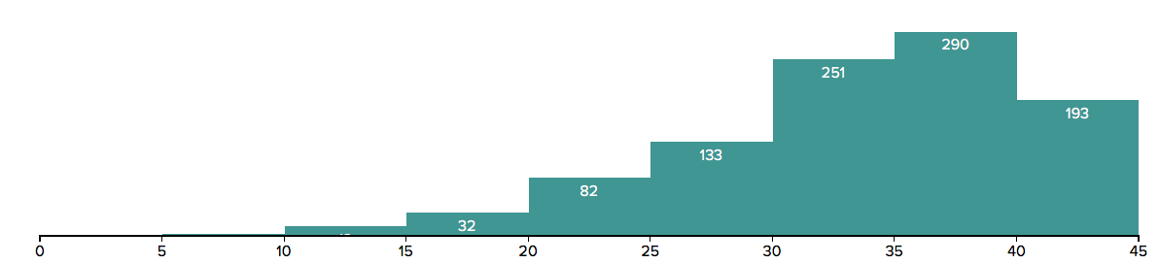
Midterm grade distribution

Slide 30
Hypothesis Testing

Slide 31
Testing a Hypothesis
Step 1: Select Two Hypotheses
A test chooses between two views of how data were generated: Null hypothesis proposes that data were generated at random; Alternative hypothesis proposes some effect other than chance
Step 2: Choose a Test Statistic
A value that can be computed from the data
Step 3: Compute What The Null Hypothesis Predicts
Compute the distribution of the test statistic: what the test statistic might be if the null hypothesis were true.
Step 4: Compare the Prediction to the Observed Data

Slide 32
Hypothesis Testing Logic
Define 2 mutually exclusive descriptions: either this or that.
One of them can be evaluated using probability (the null hypo.)
You can "reject the null," so then you accept the alternative.
Otherwise: you're still not sure, but null looks plausible.

Slide 33
Step 1: Select Two Hypotheses

Slide 34
Example: The Two Hypotheses
Gregor Mendel (1822-1884) was an Austrian monk and founder of the modern field of genetics. Among many experiments, he tested the hypothesis that pea plants will bear purple or white flowers at random, in the ratio 3:1.
Mendel’s model describes the world. If the distribution of the observed plants is different from the distribution in the model, it's just chance variation.
Mendel’s model doesn't.
Null
Alternative
(Demo)

Slide 35
Example: Smoking and Babies
Researchers are interested in whether there is an association between smoking mothers and the health of their babies. For each birth, they record the baby's birth weight and whether the mother smokes or not.
Birth weights aren't affected by maternal smoking. The birthweight distribution for babies of smokers is same as that of babies of non-smokers.
They are affected.
Null
Alternative

Slide 36
Example: Smoking and Babies
Researchers are interested in whether there is an association between smoking mothers and the health of their babies. For each birth, they record the baby's birth weight and whether the mother smokes or not.
Birth weights aren't affected by maternal smoking. The birthweight distribution for babies of smokers is same as that of babies of non-smokers.
They are lower. Birthweight of babies of smokers are lower than birthweights of babies of non-smokers.

Slide 37
Attendance
bit.ly/attend8

Slide 38
Step 2: Choose a Test Statistic

Slide 39
Choosing a Test Statistic
Test statistic: The statistic that you have chosen to calculate, to help you decide between the two hypotheses
Goal: If the null hypothesis is false, then you expect that measuring the test statistic will allow you to reject the null

Slide 40
Choosing a Test Statistic
If the alternative hypothesis is true, will test statistic be larger than prediction, smaller, or could be either way?
For Mendel's pea flower experiment, which of the following would be reasonable test statistics? (Choose all that are OK.)
The proportion of plants with purple flowers.
The proportion of plants with white flowers.
abs(p - 0.75), where p is the proportion of plants with purple flowers.
The number of different colors in the plants flowers.
The total variation distance between the distribution in the observed data, vs the model distribution (0.75, 0.25)

Slide 41
Choosing a Test Statistic
If the alternative hypothesis is true, will test statistic be larger than prediction, smaller, or could be either way?
For the baby birth weights experiment, which of the following would be reasonable test statistics? (Choose all that are OK.)
The average birth weight of all the babies.
The proportion of babies whose mother smoked.
The average birth weight of babies of smokers, minus the average birth weight of babies of non-smokers.
The absolute value of the previous difference.

Slide 42
Absolute Values & Alternatives
Choose a test statistic where alternative hypothesis suggests which direction statistic will go.
Alternative: Smoking causes poor health.
Test statistic: Average birth weight for smokers, minus average for non-smokers.
Alternative: Smoking has some relation to health.
Test statistic: Absolute value of that difference.

Slide 43
Step 3: Compute the Distribution of the Test Statistic under the Null Hypothesis

Slide 44
Step 4: Compare the Prediction to the Observed Data

Slide 45
Conclusion of a Test
Resolve choice between null and alternative hypotheses
Compare observed test statistic to its empirical distribution under the null hypothesis
If the observed value is consistent with the distribution, then the test does not reject the null hypothesis
Whether a value is consistent with a distribution:
A visualization may be sufficient
Convention: The observed significance level (P-value)

Slide 46
Quantifying Conclusions
Step 0: Go find some data. These are the observations.
Step 1: Two descriptions of the world:
Null: Data come from a well-defined random process
Alternative: Something else is going on
We evaluate how unusual the data would be under the null
Step 2: Choose a test statistic to summarize the data.
Step 3: Compute the following probability (p-value)
P(the test statistic would be equal to or more extreme than the observed test statistic under the null hypothesis)

Slide 47
Definition of P-value
The P-value is the chance,
under the null hypothesis,
that the test statistic
is equal to the value that was observed in the data or is even further in the direction of the alternative.

Slide 48
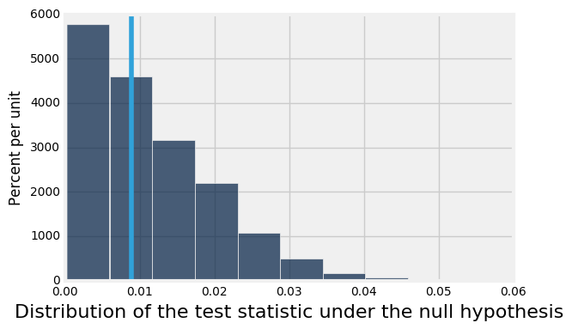
Quantifying Conclusions
P(the test statistic would be equal to or more extreme than the observed test statistic under the null hypothesis)
Evaluating Mendel's pea flower hypothesis
This area is the P-value (approximately)

Slide 49
Conventions of Consistency
“Inconsistent”: The test statistic is in the tail of the null distribution.
“In the tail,” first convention:
The area in the tail is less than 5%.
The result is “statistically significant.”
“In the tail,” second convention:
The area in the tail is less than 1%.
The result is “highly statistically significant.”

Slide 50
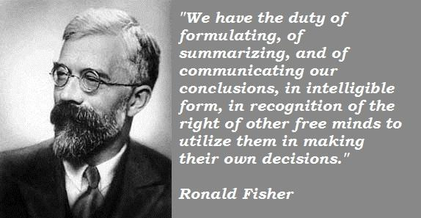
Sir Ronald Fisher, 1890-1962

Slide 51
Sir Ronald Fisher, 1925
“It is convenient to take this point [5%] as a limit in judging whether a deviation is to be considered significant or not.”
–– Statistical Methods for Research Workers

Slide 52
Sir Ronald Fisher, 1926
“If one in twenty does not seem high enough odds, we may, if we prefer it, draw the line at one in fifty (the 2 percent point), or one in a hundred (the 1 percent point). Personally, the author prefers to set a low standard of significance at the 5 percent point …”

Slide 53
Sir Ronald Fisher, 1935
“No isolated experiment, however significant in itself, can suffice for the experimental demonstration of any natural phenomenon.”

Slide 54
Can the Conclusion be Wrong?
Yes.
 | Null is true | Alternative is true
Test rejects the null | ❌ | ✅
Test doesn’t reject the null | ✅ | ❌

Slide 55
An Error Probability
The cutoff for the P-value is an error probability.
If:
your cutoff is 5%
and the null hypothesis happens to be true
(but you don’t know that)
then there is about a 5% chance that your test will reject the null hypothesis anyway.
(Demo)

Slide 56
Module 7
Examples and Error Probabilities

Slide 57
Announcements

Slide 58
Testing a Hypothesis
Step 1: Select Two Hypotheses
A test chooses between two views of how data were generated: Null hypothesis proposes that data were generated at random; Alternative hypothesis proposes some effect other than chance
Step 2: Choose a Test Statistic
A value that can be computed from the data
Step 3: Compute What The Null Hypothesis Predicts
Compute the distribution of the test statistic: what the test statistic might be if the null hypothesis were true.
Step 4: Compare the Prediction to the Observed Data

Slide 59
Conclusions From a Test
Can't reject the null hypothesis (inconclusive, don't know)
Hypothesis test
Reject the null hypothesis (accept the alternative)

Slide 60
Can the Conclusion be Wrong?
Yes.
 | Null is true | Alternative is true
Test rejects the null | ❌ | ✅
Test doesn’t reject the null | ✅ | ?

Slide 61
Setting a Cutoff
Let's draw a cutoff point for where we'll reject the null.
Won't reject the null
Will reject the null
Evaluating Mendel's pea flower hypothesis
This area is the probability of wrongly rejecting the null

Slide 62
How Much Risk To Accept?
First convention:
Accept a 5% risk of wrongly rejecting the null.
The result is “statistically significant.”
Second convention:
Accept a 1% risk of wrongly rejecting the null.
The result is “highly statistically significant.”

Slide 63
Sir Ronald Fisher, 1890-1962

Slide 64
Sir Ronald Fisher, 1925
“It is convenient to take this point [5%] as a limit in judging whether a deviation is to be considered significant or not.”
–– Statistical Methods for Research Workers

Slide 65
Sir Ronald Fisher, 1926
“If one in twenty does not seem high enough odds, we may, if we prefer it, draw the line at one in fifty (the 2 percent point), or one in a hundred (the 1 percent point). Personally, the author prefers to set a low standard of significance at the 5 percent point …”

Slide 66
Sir Ronald Fisher, 1935
“No isolated experiment, however significant in itself, can suffice for the experimental demonstration of any natural phenomenon.”

Slide 67
Attendance
bit.ly/attend8

Slide 68
Quantifying Conclusions
P(the test statistic would be equal to or more extreme than the observed test statistic under the null hypothesis)
Evaluating Mendel's pea flower hypothesis
This area is the P-value (approximately)

Slide 69
An Error Probability
The cutoff for the P-value is an error probability.
If:
your cutoff is 5%
and the null hypothesis happens to be true
(but you don’t know that)
then there is about a 5% chance that your test will reject the null hypothesis anyway.
(Demo)

Slide 70
Deflategate

Slide 71

Deflategate

Slide 72

Tom Brady Then

Slide 73
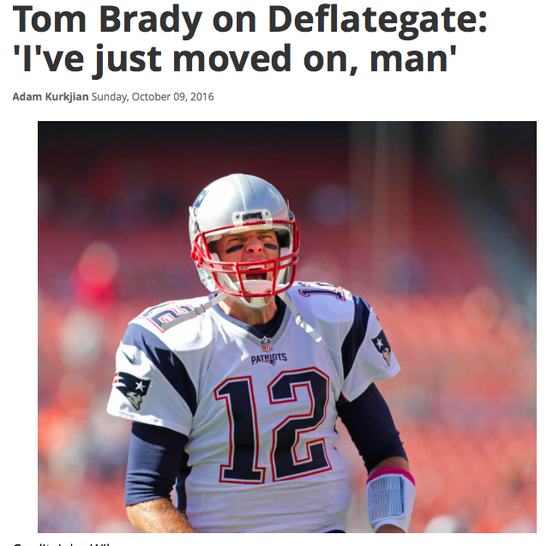
Tom Brady Now
Boston Globe,
Sunday 10/9/16
(Demo)

Slide 74
Module 7
Midterm Exam Review

Slide 75
Announcements

Slide 76
Histograms

Slide 77
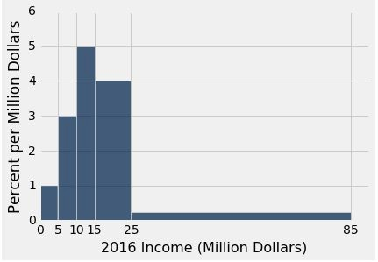
Using the Density Scale
Which bin has more people: [10, 15) or [15, 25)?
What percent of incomes are in the [25,85) bin?
If you draw one bar over [10,25), how tall will it be?
Find (or give bounds for) the median income.

Slide 78
Answers
(a) [15, 25)
(b) 15%
4.33 percent per million dollars
At least 15 and less than 25

Slide 79
Probability

Slide 80
Exercise 1
I pick one of the 12 months at random. Independently, you pick one of the 12 months at random.
What is the chance that we both pick the same month?
(i) (1/12) * (1/12)
(ii) (1/12) + (1/12)
(iii) 1/12
(iii) = (12/12) * (1/12)

Slide 81
Exercise 2
Marbles: G, G, G, G, R, R, R, B, B, Y. Draw 4 at random.
P(no G) = ?
If with replacement:
(6/10)*(6/10)*(6/10)*(6/10)
If without replacement:
(6/10)*(5/9)*(4/8)*(3/7)
P(all G) = ?
If with replacement:
(4/10)*(4/10)*(4/10)*(4/10)
If without replacement:
(4/10)*(3/9)*(2/8)*(1/7)

Slide 82
Exercise 3
Marbles: G, G, G, G, R, R, R, B, B, Y. Draw 4 times at random with replacement.
1 - (6/10)*(6/10)*(6/10)*(6/10) is the chance of: at least one G
(4/10)**4 + (3/10)**4 + (2/10)**4 + (1/10)**4 is the chance of: all four are the same color

Slide 83
Testing Hypotheses

Slide 84
Before You Compute Anything
Figure out the viewpoint the question wants to test, and formulate:
Null hypothesis: Completely specified chance model under which you can simulate data
Alternative hypothesis: Viewpoint comes from the question
Test statistic: to help you choose one viewpoint
Say what kind of values of the statistic will make you lean towards each alternative

Slide 85
Permutation | Bootstrap
Hypothesis Testing
Estimation
Is there an association between (label) and (statistic of measurement)?
Permute label (or measurement) order, compute statistic, compare distribution under null to observed
What is the population value of a parameter based on this sample?
Resample (with replacement), compute statistic that targets parameter, compute percentiles of bootstrap statistics for CIs

Slide 86
Climbers
Suppose we have “C+” climbers that climb faster on average when drinking black tea before a climb compared to climbing without tea.
What is the null and alternative hypothesis?
How would you test the hypothesis that they climb better after drinking tea?
How would you estimate the average climbing speed of the climbers that drank tea (with confidence)?

Slide 87
Categorical Data

Slide 88
Null Hypothesis
The sample is drawn at random from a specified categorical distribution.
Swain’s jury panel was drawn at random from a population that had 26% black men
Each pea plant has 75% chance of being purple flowering, regardless of other plants
The Alameda County jury panels were drawn at random from the specified distribution of eligible jurors

Slide 89
Swain v. Alabama
Null: Swain’s jury panel was drawn at random from a population that had 26% black men
Alternative: There were too few black men on the panel for it to look like a random sample
Test statistic:
Number of black men in panel
P-value direction: to the left

Slide 90
Mendel’s Model
Null: Each pea plant has 75% chance of being purple flowering, regardless of other plants
Alternative: The model isn’t good.
Test statistic:
| percent purple in sample - 75 |
P-value direction: to the right
Could also have used TVD; direction is still to the right TVD = (|prop. purple - 0.75| + |prop. white - 0.25|)/2

Slide 91
Alameda County Jury Panels
Null: The Alameda County jury panels were drawn at random from the specified distribution of eligible jurors
Alternative: The panels were not drawn at random from the specified distribution.
Test statistic:
TVD
P-value direction: to the right

Slide 92
Numerical Data

Slide 93
GSI’s Defense
Null:
Alternative:
Test statistic:

Slide 94
Comparing Two Samples

Slide 95
Birthweights
Null: In the population, the distributions of the birth weights of the babies in the two groups are the same.
Alternative: In the population, the babies of the mothers who didn’t smoke (B) were heavier, on average, than the babies of the smokers (A).
Test statistic:
Group B sample average - Group A sample average
P-value direction: to the right

Slide 96
Deflategate
Null:
Alternative:
Test statistic:

Slide 97
Null: The distribution of all the potential control scores
RCT
is the same as the distribution of all the potential treatment scores.
Alternative: The distribution of all the potential control scores is different from the distribution of all the potential treatment scores.
Test statistic:
| control group average - treatment group average |
P-value direction: to the right

